Slide 1
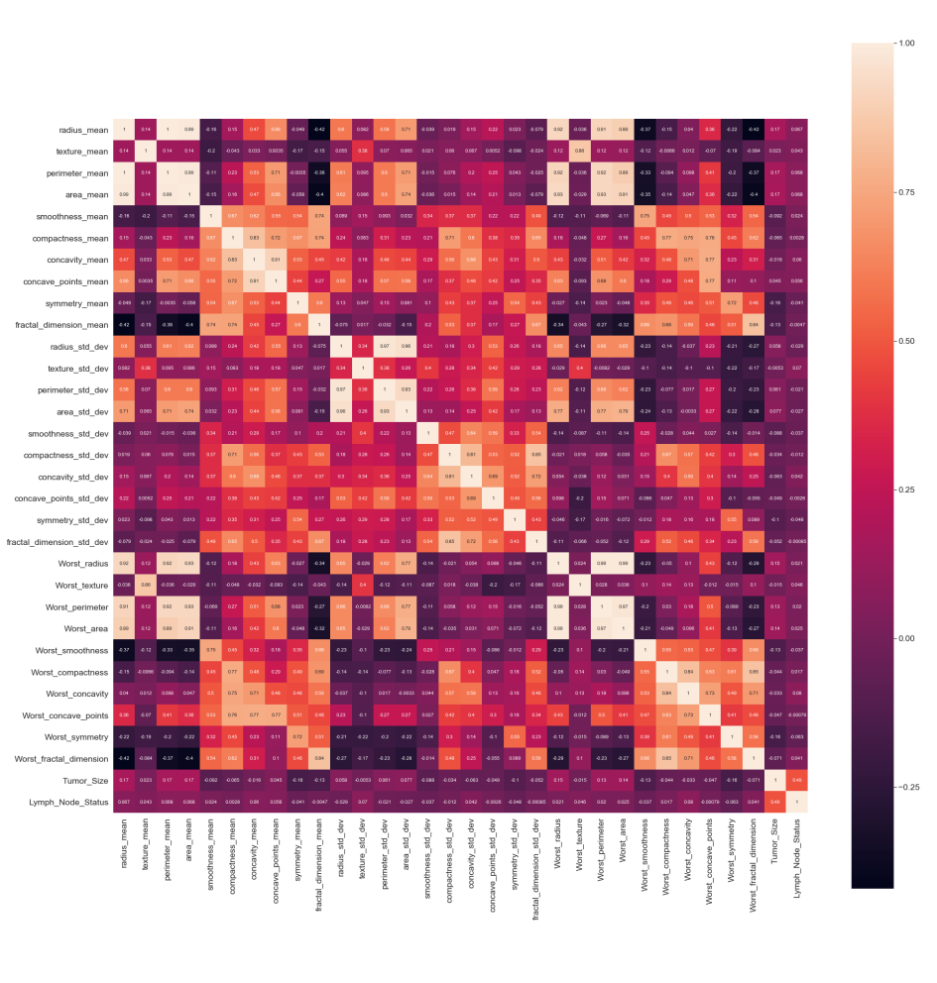
Predicting Breast Cancer Outcome of a new Patient
^{Algorithm:}
Upload Data Set
Using panda we will import data set.
Removing the Non Significant Data
We will remove columns such as ID and Outcome and rows with values NA which have no significance
in predicting output.
Using Feature Engineering
Using Python seaborn we generate heat.
If correlation is near to 1 or -1 there is a strong association among variables and
if its closer to 0 relation ship is weak.
Removing MultiCollinearity
Having highly correlated variables could affect the accuracy of model in a negative way.
So we will drop the highly correlated attributes.
Heat Map

Slide 2
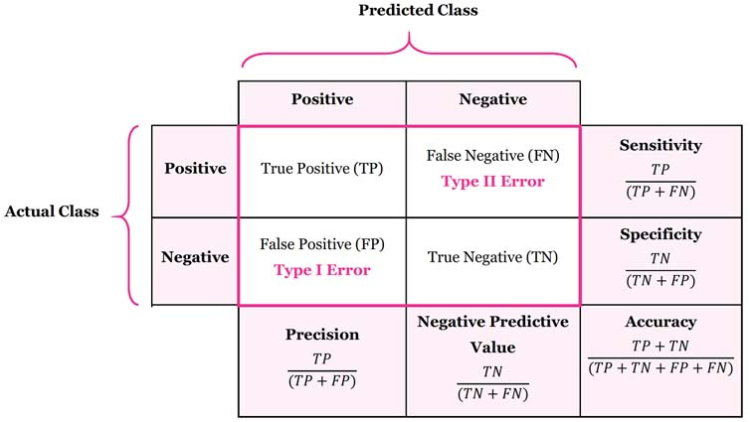
Standardizing
We rescale our attributes so that they have a mean value of 0 and a standard deviation of 1.
Split Data into Training and Testing
Now we construct the training set and the testing.80% data for training and 20% for test set.
We will use Logistic Regression algorithm by the scikit-learn to build our model and fit the data to our training data.
Running the Model
We will use confusion matrix for evaluation of our model.
Confusion Matrix

Slide 3
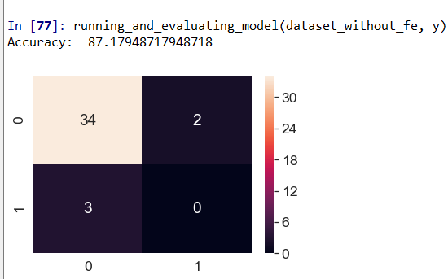
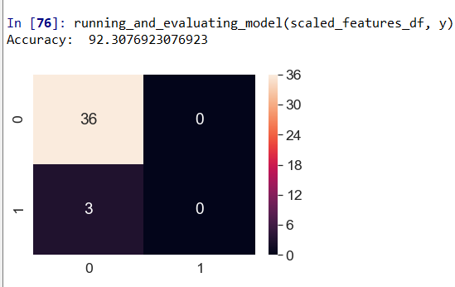
Evaluating the Model
1.Using Dataset when highly correlated variables were not dropped.
Accuracy = (True Positive + True Negative)/population size i.e (34+0)/39
Accuracy= 87.179
False negative = 3
2.Now using Feature Engineered Dataset
Accuracy = (36+0)/39 =92.307
False Negative = 3
Though the accuracy is increased but number of false negative remain same. One primary reason for it is limited data points in dataset.

Slide 4
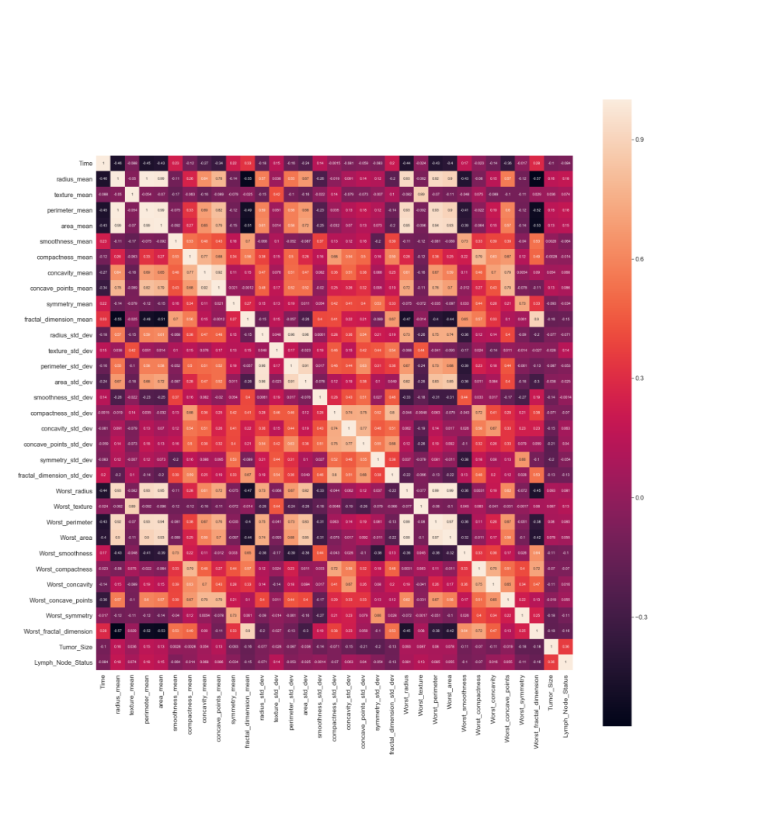
Predicting Recurrence Time for patients whose outcome is R.
^{Algorithm:}
Upload Data Set
Using panda we will import data set.
Removing the NonSignificant Data
We will drop rows where disease has not recurred and rows which have NA values and columns like ID and Outcome.
Using Feature Engineering
We will build a heat map amongst the attributes to check which attributes are strongly correlated with our Dependent variable Time.
Removing MultiCollinearity
We will drop the highly correlated attributes to avoid their negative impact on the model’s accuracy.
Standardizing
Using sklearn-pandas library we will perform standardization.
Heat Map

Slide 5

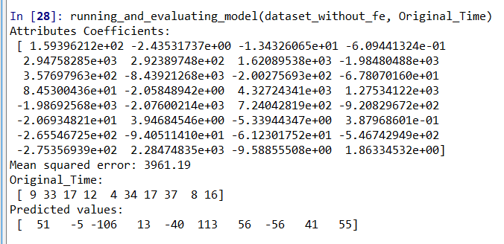
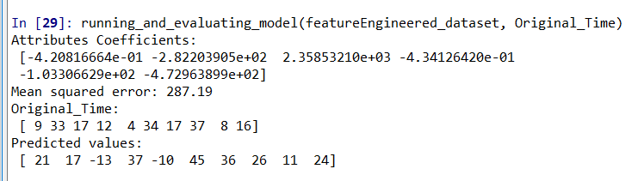
Split Data into Training and Testing
We split data set into 80% for training set and 20% for the test set.
Running and evaluating Model
We will Mean Square Error method we will evaluate our model.The smaller the MSE, the better prediction.
The coefficients along with their sign denote how the response varies with change in the input variables.
Now Evaluate
1. Using Dataset when highly 2. Using Feature Engineered Dataset correlated variables were not dropped.
Both Models have high MSE which indicates model has not performed well beacuse of the primary reason of less amount of data points in dataset.

